Slide 1
Learn Python 12
Vishal Yelisetti

Slide 2
Agenda
Homework
Joke 1
Theory: OOP concepts
Joke 2
Github
Joke 3
No homework this week :)

Slide 3
Theory: Abstraction
Abstraction is a process where you show only “relevant” data and “hide” unnecessary details of an object from the user.
Example:
Car (Object)
Steering mechanism
Engine
Gear System

Slide 4
Theory: Encapsulation
Encapsulation is:
Binding the data with the code that manipulates it.
It keeps the data and the code safe from external interference
Power steering
They work synchronously to turn the car in the desired direction. It even controls the power delivered by the engine to the steering wheel.
But to the external world there is only one interface is available and rest of the complexity is hidden. Moreover, the steering unit in itself is complete and independent. It does not affect the functioning of any other mechanism.

Slide 5
Theory: Inheritance
Inheritance is the mechanism by which an object acquires the some/all properties of another object(hierarchical classification)
Car is a four wheeler vehicle so assume that we have a class FourWheeler and a sub class of it named Car. Here Car acquires the properties of a class FourWheeler. Other classifications could be a jeep, tempo, van etc. FourWheeler defines a class of vehicles that have four wheels, and specific range of engine power, load carrying capacity etc. Car (termed as a sub-class) acquires these properties from FourWheeler, and has some specific properties, which are different from other classifications of FourWheeler, such as luxury, comfort, shape, size, usage etc.

Slide 6
Theory: Polymorphism
Polymorphism means to process objects differently based on their data type.
One method with multiple implementation, for a certain class of action. And which implementation to be used is decided at runtime depending upon the situation (i.e., data type of the object)
Overloading in simple words means more than one method having the same method name that behaves differently based on the arguments passed while calling the method. This called static because, which method to be invoked is decided at the time of compilation
Overriding means a derived class is implementing a method of its super class. The call to overriden method is resolved at runtime, thus called runtime polymorphism(Dynamic)

Slide 7
Agenda
- Homework
- Regular Expressions
- Lambda Expressions
- Github Tutorial
- Installing Pycharm
- PyGames Book

Slide 8
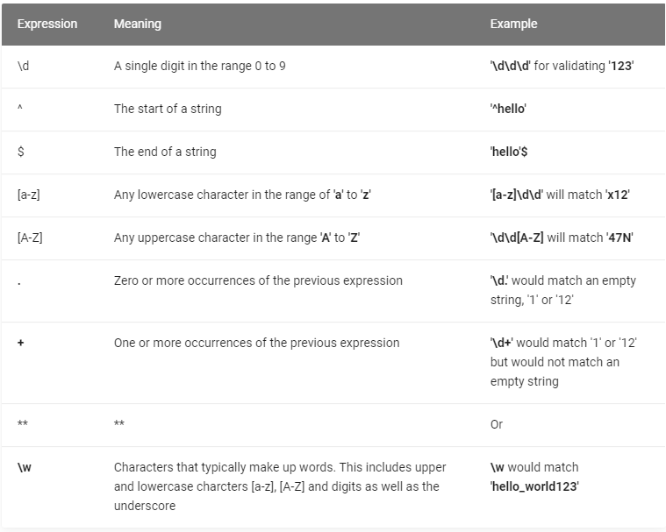
Regular Expressions
Regex101.com

Slide 9

Lambda Operations/Functions
A lambda function is a small anonymous function.
A lambda function can take any number of arguments, but can only have one expression.
$$\text{lambda} \text{arguments} \text{: }\text{expression}$$

Slide 10
Lambda Operations/Functions
Basic Lamba operator: https://cutt.ly/gghUDLF
Lambda Functions: https://cutt.ly/HghUHcV

Slide 11
Github Tutorial
Team 6328
Software Engineering

Slide 12

Overview
Install git and create a Github account
What is git?
How does git work?
What is GitHub?
Quick example using git and GitHub
Github icon

Slide 13

1
Install git and a create GitHub account

Slide 14
Install git
Linux (Debian)
Command: sudo apt-get install git
Linux (Fedora)
Command: sudo yum install git
Mac
http://git-scm.com/download/mac
Windows
http://git-scm.com/download/win

Slide 15
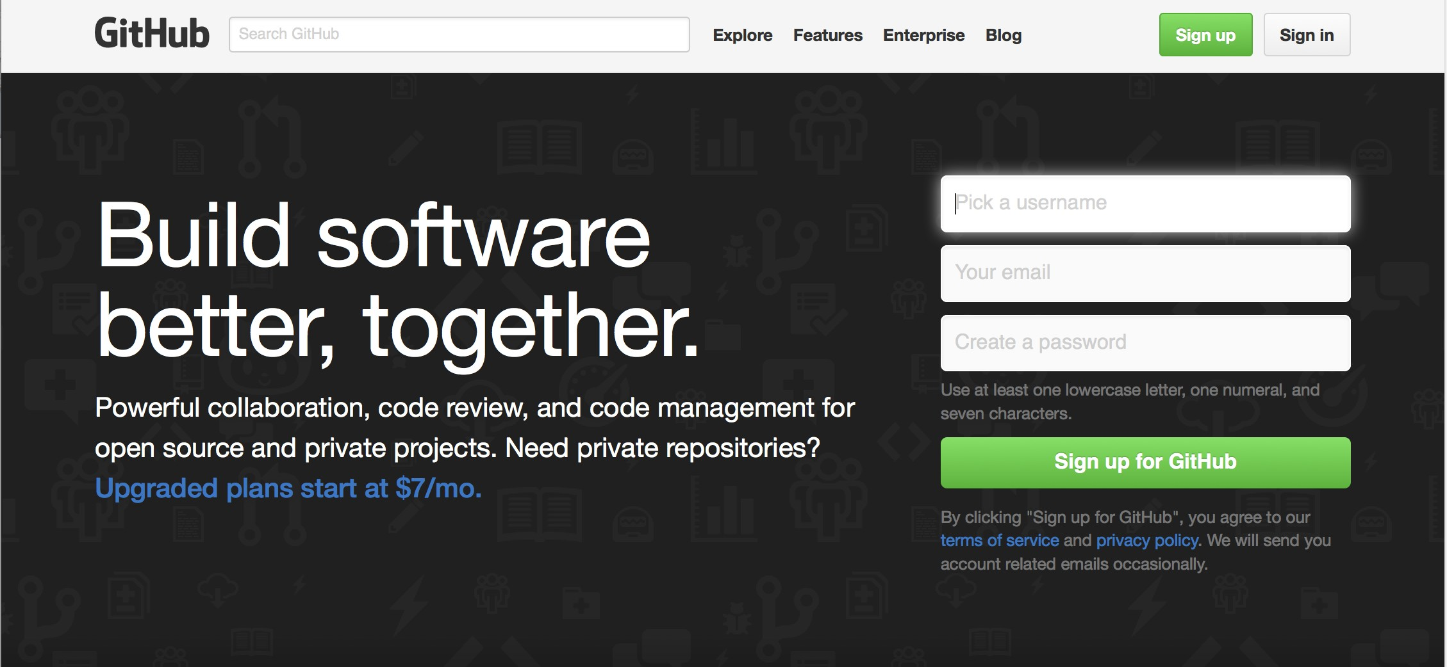
Create Github account
www.github.com
Free for public repositories

Slide 16
What is version control?
A system that keeps records of your changes
Allows for collaborative development
Allows you to know who made what changes and when
Allows you to revert any changes and go back to a previous state

Slide 17

2
What is git?

Slide 18
What is version control?
Distributed version control
Users keep entire code and history on their location machines
Users can make any changes without internet access
(Except pushing and pulling changes from a remote server)

Slide 19

What is git?
Started in 2005
Created by Linus Torvald to aid in Linux kernel development
Git icon

Slide 20



What is git?
Git isn’t the only version control system
But (we think) it’s the best

Slide 21

3
How does git work?

Slide 22
How does git work?
Can be complicated at first, but there are a few key concepts
Important git terminology in following slides are blue

Slide 23
Key Concepts: Snapshots
The way git keeps track of your code history
Essentially records what all your files look like at a given point in time
You decide when to take a snapshot, and of what files
Have the ability to go back to visit any snapshot
Your snapshots from later on will stay around, too

Slide 24
Key Concepts: Commit
The act of creating a snapshot
Can be a noun or verb
“I commited code”
“I just made a new commit”
Essentially, a project is made up of a bunch of commits

Slide 25
Key Concepts: Commit
Commits contain three pieces of information:
Information about how the files changed from previously
A reference to the commit that came before it
Called the “parent commit”
A hash code name
Will look something like:
fb2d2ec5069fc6776c80b3ad6b7cbde3cade4e

Slide 26
Key Concepts: Repositories
Often shortened to ‘repo’
A collection of all the files and the history of those files
Consists of all your commits
Place where all your hard work is stored

Slide 27
Key Concepts: Repositories
Can live on a local machine or on a remote server (GitHub!)
The act of copying a repository from a remote server is called cloning
Cloning from a remote server allows teams to work together

Slide 28
Key Concepts: Repositories
The process of downloading commits that don’t exist on your machine from a remote repository is called pulling changes
The process of adding your local changes to the remote repository is called pushing changes

Slide 29
Key Concepts: Branches
All commits in git live on some branch
But there can be many, many branches
The main branch in a project is called the master branch

Slide 30
So, what does a typical project look like?
A bunch of commits linked together that live on some branch, contained in a repository
Following images taken and modified from:
http://marklodato.github.io/visual-git- guide/index-en.html
Also a good tutorial!

Slide 31
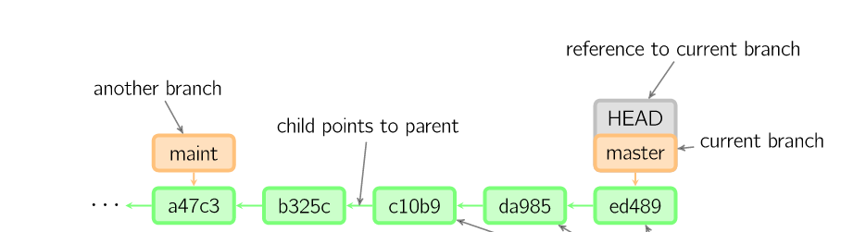

So, what does a typical project look like?
Time going forward

Slide 32

So, what is HEAD?
Time going forward

Slide 33
So, what is HEAD?
A reference to the most recent commit
Time going forward

Slide 34
So, what is HEAD?
A reference to the most recent commit
(in most cases – not always true!)
Time going forward

Slide 35
So, what is MASTER?
The main branch in your project
Doesn’t have to be called master, but almost always is!
Time going forward

Slide 36
Key Concepts: Branching oﬀ of the master branch
The start of a branch points to a specific commit
When you want to make any changes to your project you make a new branch based on a commit

Slide 37
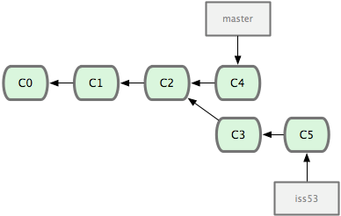
Key Concepts: Branching oﬀ of the master branch
Images from: http://codingdomain.com/ git/merging/
Time going forward

Slide 38
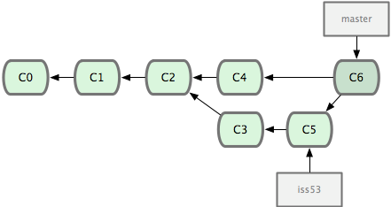

Key Concepts: Merging
Once you’re done with your feature, you merge it back into master
Time going forward

Slide 39
Key Concepts: How do you make a commit anyway?
There are a lot of ‘states’ and ‘places’ a file can be
Local on your computer: the ‘working directory’
When a file is ready to be put in a commit you add it onto the ‘index’ or ‘staging’
Staging is the new preferred term – but you can see both ‘index’ and ‘staging’ being used

Slide 40
Key Concepts: How do you make a commit anyway?
The process:
Make some changes to a file
Use the ‘git add’ command to put the file onto the staging environment
Use the ‘git commit’ command to create a new commit’

Slide 41
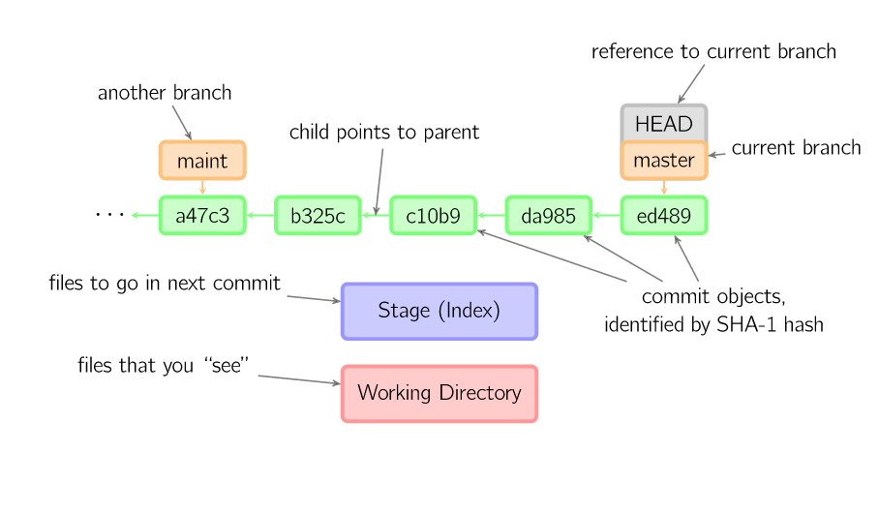

Key Concepts: How do you make a commit anyway?
Time going forward

Slide 42
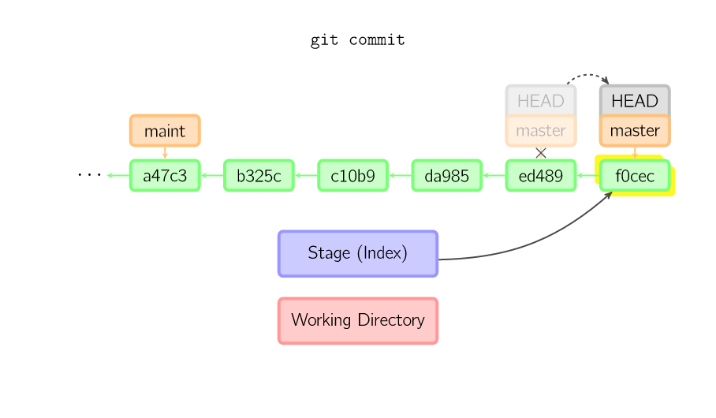
Key Concepts: How do you make a commit anyway?
Time going forward

Slide 43

4
What is GitHub?

Slide 44

What is GitHub?
www.github.com
Largest web-based git repository hosting service
Aka, hosts ‘remote repositories’
Allows for code collaboration with anyone online
Adds extra functionality on top of git
UI, documentation, bug tracking, feature requests, pull requests, and more!
Octocat!

Slide 45
What is GitHub?
Founded in 2008
Also has an Enterprise edition for businesses
Octocat!

Slide 46


Additional Resources

Slide 47
Additional Resources
Oﬃcial git site and tutorial:
https://git-scm.com/
GitHub guides:
https://guides.github.com/
Command cheatsheet:
https://training.github.com/kit/ downloads/github-git-cheat-sheet.pdf
Interactive git tutorial:
https://try.github.io/levels/1/challenges/1
Visual/interactive cheatsheet:
http://ndpsoftware.com/git-cheatsheet.html

